Slide 1


Table 3’s Treasure Trove of Tables
pew pew pew

Slide 2
How to Create a Table
Tables are created using the <table> tag
Tables consist of a header, body and footer sections
<th> tag defines a header cell within a row
<tr> tag defines a table row
<td> tag defines a data cell within a row
width defined by content

Slide 3
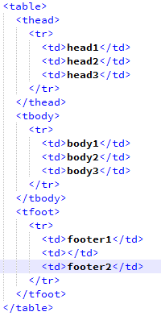
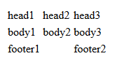
How to add a Header and Footer
Headers are created with the <thead> tag
Body for the table is created with the <tbody> tag
Footers are created with the <tfoot> tag
Example:

Slide 4
Formatting tables with CSS commands :D
border-collapse: collapse, border-collapse: separate
Default is border-collapse: separate. This determine spacing between borders exists or not, in the event of multiple borders being collapsed, the more dominant border will be displayed.
border-spacing
specifies the space between cells when borders are separate. Can be relative or absolute.
padding
Determines the space between the contents of the table cell and the outer edge of the cell
text-align
The horizontal alignment of text
vertical-align
The vertical alignment of text.

Slide 5
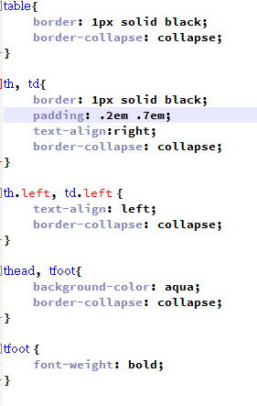
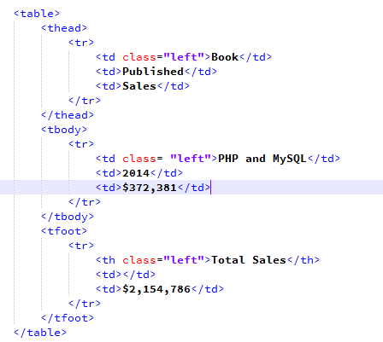


HTML
CSS

Slide 6
CSS3 Structural pseudo-classes for formatting tables :)
Using pseudo classes simplifies html by not being forced to use id and class selectors.
commands include :nth-child(n) , nth-last-child(n) , nth-last-of-type(n)
Typical values for the (n) include
odd: every odd child/element
even: every even child/element
n: the nth chill or element
2n: same as even
3n: every third child or element( 3, 6, 9)
2n+1: same as odd
3n+1: every third child or element starting with 1.

Slide 7
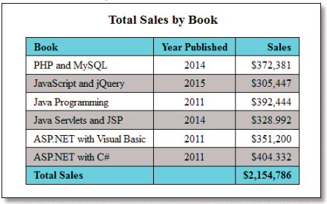
HTML5 Figure and Figcaption Elements
<figure>
<figcaption>Total Sales by Book</figcaption>
<table>
...
</table>
</figure>
Figcaption elements are inline elements
Use the display: property to change this in CSS
Captions are displayed above of the table
The figure element acts like a container

Slide 8
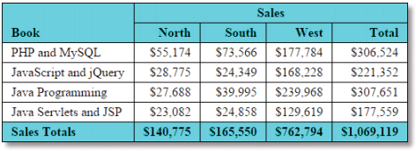
Merging Cells
<table>
<thead>
<tr>
<th rowspan="2">Book</th>
<th colspan="2">Sales</th>
</tr>
<tr>
<th>North</th>
<th>South</th>
<th>West</th>
<th>Total</th>
</tr>
</thead>
<tbody>
...
</tbody>
<tfoot>
...
</tfoot>
</table>
Merging is done via HTML, not CSS
Use the colspan attribute to merge cells in the same row across 2+ columns
Use the rowspan attribute to merge cells in the same column across 2+ rows

Slide 9
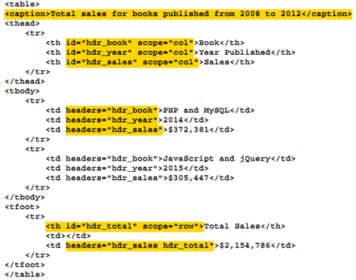
Attributes for accessibility
Caption-Describes the content of a table.
Headers- Describes the content of the cell.
Scope-Keywords that associate to cell with
a row or column.
- “row” and “col” are often used
- “rowgroup” for merged cells.

Slide 10
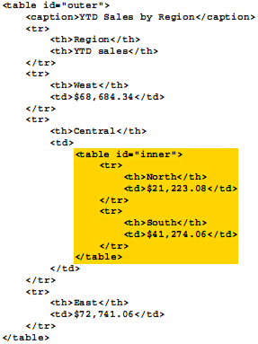
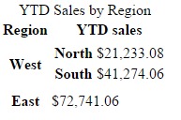
Tableception
You can nest one table within another table by coding a table element within a td.
Table nesting is rarely used
Ex:

Slide 11
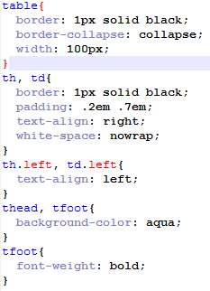
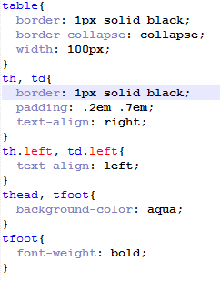

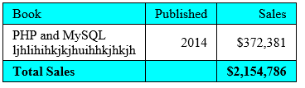
How to control wrapping
Use the white-space: nowrap; property on the table in css to get tables to stop wrapping.
Be careful This could cause stuff to go off the side of the page.
Note that the two figures have been sized the same.
No wrap
Wrap
No wrap
Wrap

Slide 12
RESERVED FOR IN CLASS ACTIVITY
Switch to in class activity.

